Slide 1

git local
Presented
by
Sushanth bobby lloyds

Slide 2
Agenda
About git
concepts & terminology
Git Local
basic commands
Undo’s
Resets
Stash
Branching
Reflog
Rebase
Handling Conflicts
Internals
Architecture
Hashes
Objects
.git directory
commit, tree & blob
git cat-file
git gc
ungit
Notes:
init, add, status, remove, remove --cached, .gitignore, commit, log, git diff
Reset checkout, reset, soft, mixed, hard
stash
tag
Branching & Merging
reflog
rebase
Handling Conflicts
Internals
Architecture
Hashes
Objects
.git directory
commit, tree & blob
git cat-file
git gc
ungit

Slide 3
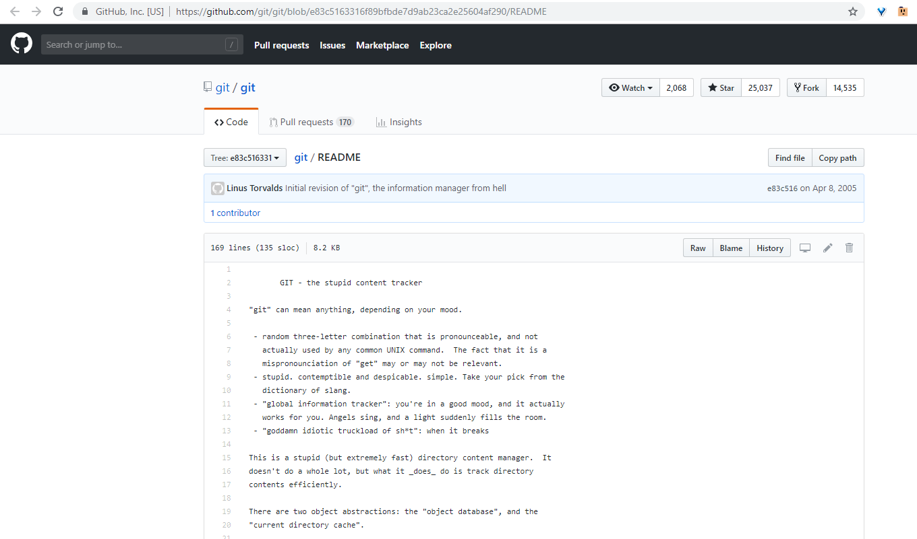
What is git ?
https://github.com/git/git/blob/e83c5163316f89bfbde7d9ab23ca2e25604af290/README

Slide 4
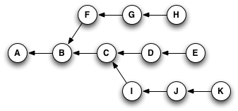
What is git ?
Git is a distributed version control system. A version control system is a tool that allows us to manage changes made to blobs.
It is a tool that allows you to track your code history.
Allows you to peek into the past and see what a code looks like at any given point of development.
Git records the current state of the project by creating a tree graph from the index. It is usually in the form of a Directed Acyclic Graph (DAG).
Notes:
Those familiar with the graph theory will notice that this is a Directed Acyclic Graph (DAG). What that means is that the connection edges between graph nodes (in git’s case commits) are directed and if you start from one node travelling through the graph and following the edges direction you can never come to the same node that you started off (there is no “round-trips” ).

Slide 5
Git Advantages
Branch-Feature Workflow is easy
Distributed Development
Each user gets their own local repository with full history of commits, so easy to inspect previous version of file
Space
Compression can be done across repository not just per file
Minimizes local size as well as push/pull data transfers
Simplicity
Object model is very simple
Large user base

Slide 6
Git Disadvantages
Definite learning curve, especially for those used to centralized systems
Huge number of commands with Huge number of options. Enough to say ‘Is there any GUI for Git ?’
Porcelain commands – this is what most users use
Plumbing commands - for expert users
Doesn’t like binary files as they cannot be compared. So repository sizes may grow and can become slow.

Slide 7
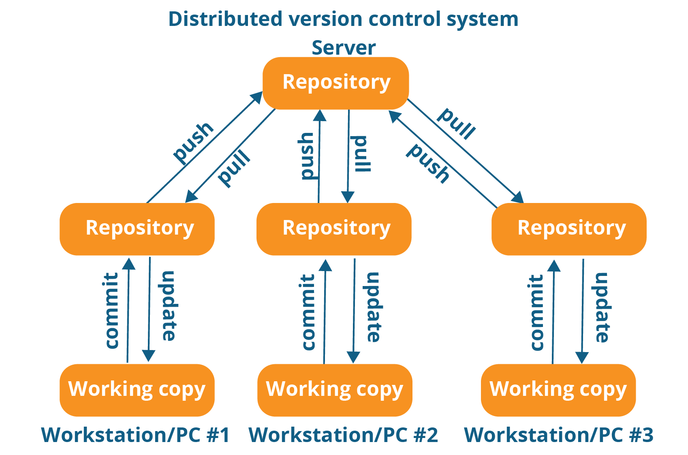
Distributed Version Control
Every contributor has a local copy or “clone” of the main repository
Users can update their local repositories with new data from the central server by an operation called “pull”
Main repository can be updated by an operation called “push” from their local repository.

Slide 8
Basic Workflow
(Possible init or clone) Initialize a repository
Edit files
Stage the changes
Review your changes
Commit the changes

Slide 9
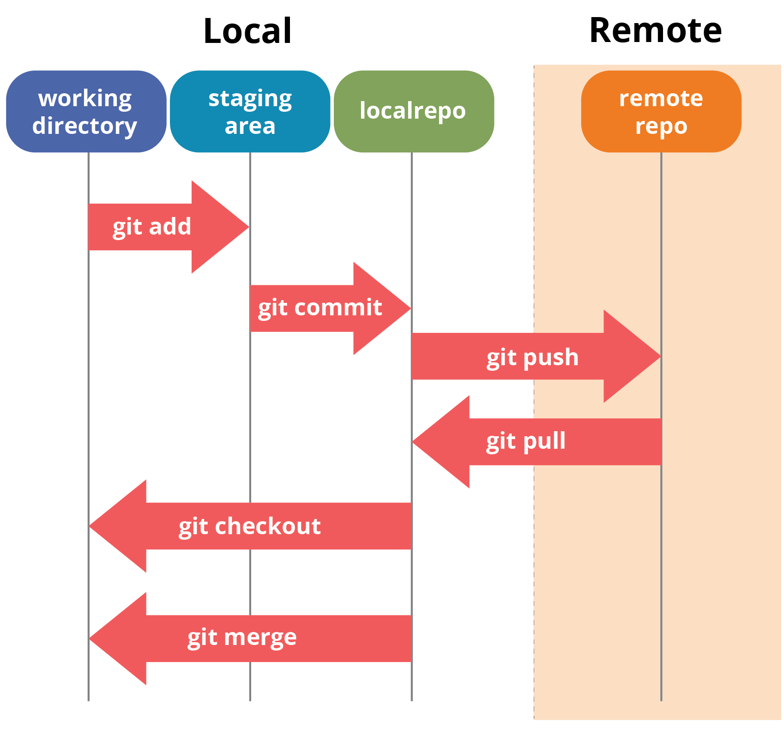
git terminology
Working directory / Working tree
Contains all the tracked and untracked files. This is also called as working-copy.
Staging area / INDEX
Contains all the committed files and all the ‘tracked modified’ files which are staged for commit is available here. Index is found in .git/index
Repository / REPO
There is a hidden folder .git. It’s a database containing complete copy of the project and data at each stage.
Remote repository
Remote file server that you use to share and store your code.

Slide 10
git concepts
A file can be in any of the following states
untracked: the file is not tracked by the Git repository. This means that the file never staged nor committed.
tracked: committed and not staged
staged: staged to be included in the next commit
dirty/modified: the file has changed but the change is not staged

Slide 11
git basics
Commands | Description
git config | Its used to setup the repository either local or global
git init | Initializes the repository
git add | Add file to the staging area
git rm --cached | Unstage & Untracks the file
git rm | Delete file from working directory & stages the deletion
.gitignore | Files/Folders mentioned in this file will be ignored
git status | View status of files in Working directory & Staging
git commit | Records the snapshot of the staging area
git log | Show commits made in that repository in reverse chronological order. (ie., latest at top )
git diff | Shows difference in files in working directory and staged
git diff --cached | Shows difference in files in staged and repository
git tag | It is used to bookmark a commit point as a milestone, stable release or version

Slide 12
git config
git config
Setup user name
git config --global user.name “sushanth”
Setup email
git config --global user.email “bobby.dreamer@gmail.com”
To setup locally with a different username and email use --local
git config --local user.name “sushanth”
git config --local user.email “bobby.dreamer@gmail.com”
To view the all the config options set
git config --list (or) git config -l
cat ~/.gitconfig
Using this config default editor can be changed( vim is the default )
git config --global core.editor nano
Use --unset option to remove a setting
git config --unset --global user.email

Slide 13
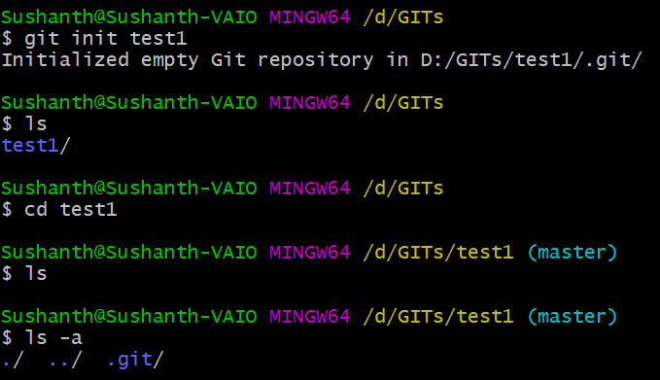
git init
git init
This will create a .git directory in your current directory.
Creates a default branch called ‘master’
Another flavor of same command
git init folder-name

Slide 14
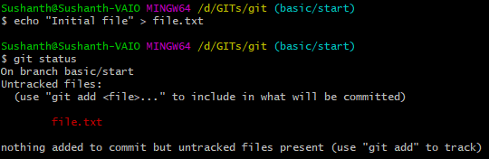
git add
We did two things above
Created a file called “file.txt”
Checked the status of the git repository
git status let you know the status of the repository at that moment and it lets you know the commands you might want to use next.
Notes:
In our case its Git add

Slide 15

git add
Working directory
Staging area
Local repo
git add
When you issue the command, git starts to track the file, first it adds file to the staging area/INDEX
Below are multiple ways a file can be added to git
Commands | Description
git add fileA.txt | Add file fileA.txt to staging area
git add fileB.txt fileC.txt | Adding multiple files to staging area
git add . | Add all files & subdirectories with files to staging area
git add f* | Add all files starting with f* to staging area

Slide 16
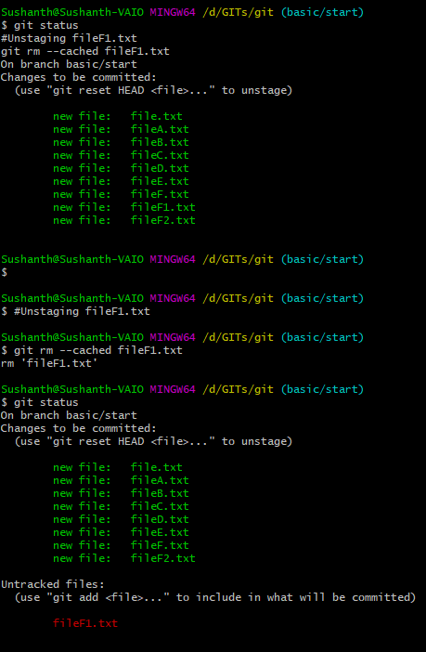
Untracking a staged file
Working directory
Staging area
Local repo
git add
git rm --cached
git rm --cached
Unstages the file
Untracks the file
Can be used to untrack a file without deleting it from working directory
git rm --cached fileF1.txt
Notes:
git rm -rf --cached .

Slide 17
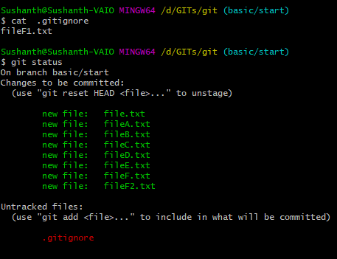
.gitignore
We can specify files to ignore for versioning/tracking in this file
Types of files we can ignore are
Confidential files
Password files
Account files
Any files which we don’t want anyone to find
In .gitignore we can mention .gitignore file itself
Solution
Create a file .gitignore
Add file naming pattern you want to ignore

Slide 18
git commit
git commit
Before we commit files in project must be in the staging area
Generates a unique SHA-1 hash (40 character string of hex digits) for every commit.
git commit internals
When you commit your change to git, it creates a commit object
A commit object represents the complete state of the project, includes all the files in the project
The very first commit object has no “parents”
Usually, you take some commit object, make some changes, and create a new commit object; the original commit object is the parent of the new commit object
Hence, most commit objects have a single parent
You can also merge two commit objects to form a new one, this new commit object has two parents
Working directory
Staging area
Local repo
git add
git commit
All circles are commit

Slide 19
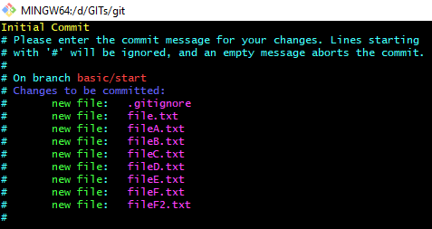
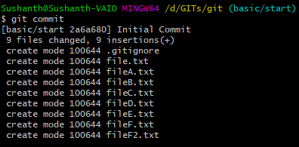
git commit
Working directory
Staging area
Local repo
git add
git commit
Before we commit files in project must be in the staging area
Generates a unique SHA-1 hash (40 character string of hex digits) for every commit.
git commit
Opens VIM by default – You can type I and start typing the comments and then [ESC] :wq to save and exit

Slide 20
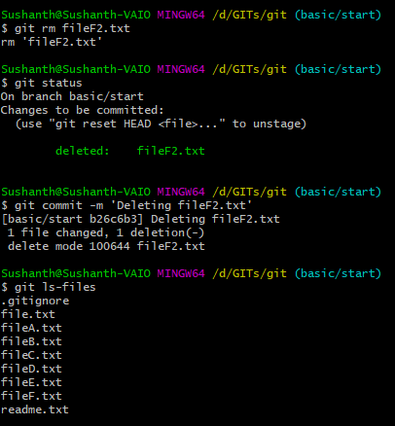
Deleting a file & Inline commit
git rm
Removes the file from working directory
Stages the file for removal
git commit –m
Lets you commit inline without opening VIM
git ls-files
Lists files in the repository

Slide 21
git commit
Committing specific files
git commit -m "Second" second.txt
Staging & Committing with inline comments in a single command
git commit -a -m ‘Add some comments here’
Amending commit
If you had missed adding a file to the recent commit, below command can be used.
git add forgottenfile.txt
git commit --amend --no-edit
--no-edit means ‘Comment does not change’
git commit --amend -m “New commit message”
Lets you change the commit message as well.
Dummy commit
git commit --allow-empty -m ‘Initial branch empty commit’

Slide 22
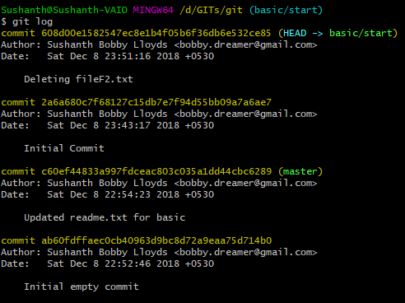
git log
How to read git log information
Latest at top
Each commit contains
SHA-1 hash
Author name
Timestamp
Comments
Which branch HEAD is pointing to
git log –p
Show changes in each commit (output could be big)

Slide 23
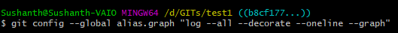

git log -> git graph
Reduced the git log output to one line
git log --all --decorate --oneline --graph
Use alias to shorten the long commands
git config --global alias.graph "log --all --decorate --oneline --graph"
NOTE : Use “git config --list” to see the global alias
Notes:
git log --all --decorate --oneline --graph
git config --global alias.graph "log --all --decorate --oneline --graph"

Slide 24
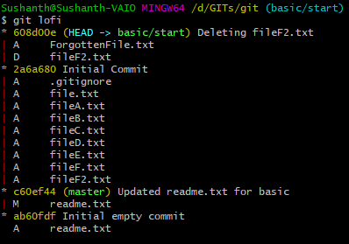
git log -> git lofi
Lets you know the files changed in each commit
git log --oneline --name-status --graph
Use alias to shorten the long commands
git config --global alias.lofi "log --oneline --name-status --graph"
NOTE : Use “git config --list” to see the global alias
Notes:
git log --oneline --name-status --graph
git config --global alias.lofi "log --oneline --name-status --graph"

Slide 25

git log -> LOgList -> git lol
Prettify git log output
git log --graph --pretty=format:'%C(yellow)%h%Creset -%C(cyan)%d%Creset %s %Cgreen(%cr) %C(magenta)<%an>%Creset' --date=relative
Git lol
git config --global alias.lol "log --graph --pretty=format:'%C(yellow)%h%Creset -%C(cyan)%d%Creset %s %Cgreen(%cr) %C(magenta)<%an>%Creset' --date=relative"
NOTE : Use “git config --list” to see the global alias
- More commands in the below notes section
Notes:
git log --graph --pretty=format:'%Cred%h%Creset-%C(yellow)%d%Creset %s %Cgreen(%cr) %C(bold blue)<%an>%Creset' --date=relative
git log --graph --pretty=format:'%Cred%h%Creset-%C(yellow)%d%Creset %s %Cgreen(%cr) %C(bold blue)<%an>%Creset' --date=relative
Few extra commands
Concatenate two commands to get the latest 2 commits
git lol | tail -n 2
Directly list latest 2
Git log -2
Reverse the git log output
Git log –reverse
Changed the colors
git config --global alias.lol "log --graph --pretty=format:'%C(yellow)%h%Creset -%C(cyan)%d%Creset %s %Cgreen(%cr) %C(magenta)<%an>%Creset' --date=relative"
List files in a commit (git FIC)
git show --pretty="" --name-only bd61ad98

Slide 26
git diff
Working Directory
Staging Area
Local Repo
HEAD
F2.txt
Lets stage this
New developments
F2.txt
Lets stage this
MASTER
C3
C2
C1
git diff
git diff --staged
C1 -- Contains (f1.txt, f2.txt)
C2 -- f3.txt
C3 -- Updated f1.txt
Notes:
Head is a pointer which usually points to a branch by which git know where we are now. This head usually points to the tip of the branch and tip of the branch contains the latest commit.

Slide 27
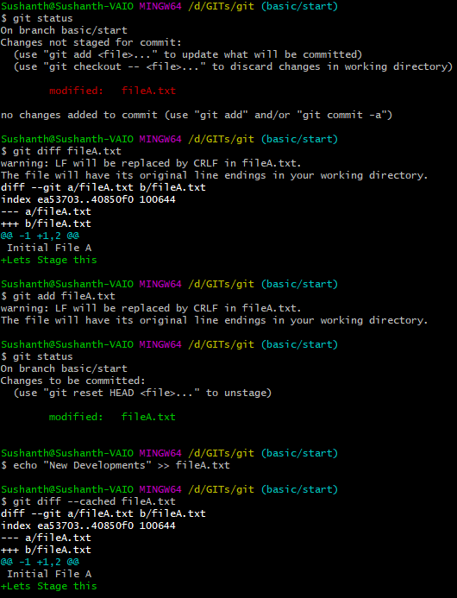
git diff
Git diff compares files in working directory & staging area/INDEX
echo "Lets Stage this" >> fileA.txt
git status
git diff fileA.txt
git add fileA.txt

Slide 28
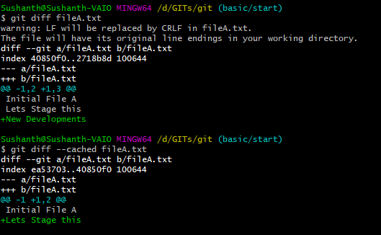
git diff --cached
Git diff –cached compares files in staging area & repository
echo "New Developments" >> fileA.txt
git diff fileA.txt
git diff --cached fileA.txt
git commit –m ‘updated fileA.txt’

Slide 29
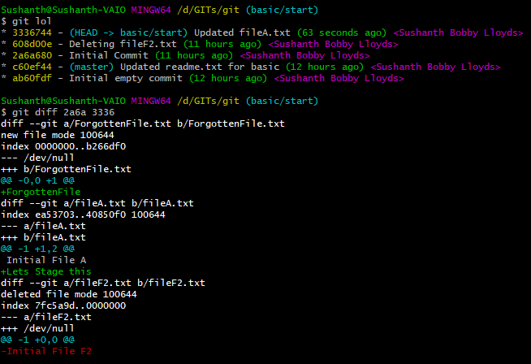
Finding difference between two commit points
Git diff <hash1> <hash2>
Shows you all the differences between two commit points
git lol
git diff 2a6a 3336
Its hard remember those commit hashes. That’s leads to next slide “git tags”

Slide 30
git tag
Tag is used to mark a particular commit point as a milestone, a new stable release or a new version.
Why use tag ?
Its easy to remember a version number than a SHA1 hash in git.
There are two types of tags
Lightweight tag
Annotated tag

Slide 31
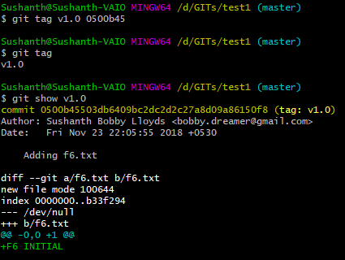
git tag – Lightweight tag
This is a simple tag which just stores hash of the commit they refer to.
Git tag <tagname>
Example : git tag v1.0
This will refer to the latest commit
Example : git tag v1.0 <hash>
This will refer to commit you specify

Slide 32
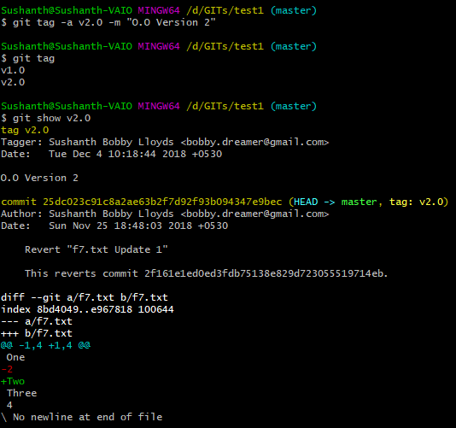
git tag – Annotated tag
This type of tag stores extra meta data information like
Tagger
when the tag was created
message
Git tag –a <tagname>
Example : git tag –a v2.0
This will refer to the latest commit
Add -m to provide inline message

Slide 33


git tag – describe
Prerequisites
git tag -a v2.0 -m "Version 2"
git describe
echo "initial f" > f.txt
git add .
git commit -m "Added f.txt - Tag Testing“
git describe
git describe is only applicable for “annotated tag”.
This attaches additional information to the tag based off the nearest annotated tag.
In the above example,
V2.0 is the nearest annotated tag
1- number of commits made after tagging
g – Git
804e1db – Hash of the latest commit

Slide 34
git tag – other operations
Commands | Description
git show <tagname> | Shows tag details
git tag | Lists all tags
git tag –l –n3 | Lists tags with messages (max 3 lines)
git tag –d <tagname> | Delete a tag
git tag –a –f <tagname> <commit> | To replace existing annotated tag
git checkout <tagname> | To view files of that specific version (detached HEAD state)
git push <location> <tagname> | A tag is just a reference to your local repository and it is not automatically pushed to the remote repository with the rest of the code.
git push <location> --tags | Push all tags at once

Slide 35
Git Basics
git diff HEAD
git diff
git diff –staged
git stash pop/apply : new files
git commit -a
git stash pop/apply
tag
git add/rm/mv
git commit
STASH
Working
Directory
Stage/Index
Local Repo
master
git stash list
git status
git log
git stash push
git show :fn
git show HEAD:fn
git rm --cached

Slide 36
Undos
Overwrite content of file in
STAGING with content from REPOSITORY
WORKING DIRECTORY with content from STAGING
Retrieving file from earlier commit
Reverting a commit

Slide 37
Undoing the changes
Initially Working Directory, Staging Area & Local Repository contains the same content for fileB.txt
Working Directory
Staging Area
Local REPO
HEAD
MASTER
fileB.txt
Initial File B
fileB.txt
Initial File B
fileB.txt
Initial File B
C3
C2
C1
Notes:
Head is a pointer which usually points to a branch by which git know where it is now. This head usually points to the tip of the branch and tip of the branch contains the latest commit.
If you have messed up file in working directory and staging area and want to startover use option(2)

Slide 38
Undoing the changes
echo "Lets stage this" >> fileB.txt
git add fileB.txt
Working Directory
Staging Area
Local REPO
HEAD
MASTER
fileB.txt
Initial File B
Lets stage this
fileB.txt
Initial File B
Lets stage this
fileB.txt
Initial File B
C3
C2
C1
Notes:
Head is a pointer which usually points to a branch by which git know where it is now. This head usually points to the tip of the branch and tip of the branch contains the latest commit.
If you have messed up file in working directory and staging area and want to startover use option(2)

Slide 39
Undoing the changes
echo "Lets stage this" >> fileB.txt
git add fileB.txt
echo "New Developments" >> fileB.txt
Now all the areas of git has different content in the same file
Working Directory
Staging Area
Local REPO
HEAD
MASTER
fileB.txt
Initial File B
Lets stage this
New Developments
fileB.txt
Initial File B
Lets stage this
fileB.txt
Initial File B
C3
C2
C1
Notes:
Head is a pointer which usually points to a branch by which git know where it is now. This head usually points to the tip of the branch and tip of the branch contains the latest commit.
If you have messed up file in working directory and staging area and want to startover use option(2)

Slide 40
Undoing the changes
To view the content in each of these areas you can use below commands
To view content in repository : git show head:fileB.txt
To view content in staging : git show :fileB.txt
To view content in working directory : cat fileB.txt
Working Directory
Staging Area
Local REPO
HEAD
MASTER
fileB.txt
Initial File B
Lets stage this
New Developments
fileB.txt
Initial File B
Lets stage this
fileB.txt
Initial File B
C3
C2
C1
cat fileB.txt
git show :fileB.txt
git show head:fileB.txt
Notes:
Head is a pointer which usually points to a branch by which git know where it is now. This head usually points to the tip of the branch and tip of the branch contains the latest commit.
If you have messed up file in working directory and staging area and want to startover use option(2)

Slide 41
Undoing the changes
Lets overwrite content in STAGING area with content from REPOSITORY
git reset HEAD fileB.txt
HEAD by default points to the tip of the branch which points to the latest commit
Copy fileB.txt from repository to staging area
Working Directory
Staging Area
Local REPO
HEAD
MASTER
fileB.txt
Initial File B
Lets stage this
New Developments
fileB.txt
Initial File B
fileB.txt
Initial File B
C3
C2
C1
git reset HEAD fileB.txt
Notes:
Head is a pointer which usually points to a branch by which git know where it is now. This head usually points to the tip of the branch and tip of the branch contains the latest commit.
If you have messed up file in working directory and staging area and want to startover use option(2)

Slide 42
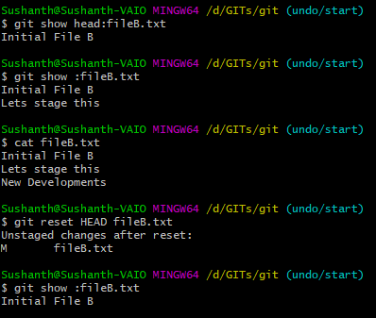
Undoing the changes
Lets overwrite content in STAGING area with content from REPOSITORY
git reset HEAD fileB.txt
HEAD by default points to the tip of the branch which points to the latest commit
Copy fileB.txt from repository to staging area
Repository
Staging area
Working directory
Overwriting content from repo
to staging
Current Staging area

Slide 43
Undoing the changes
Lets overwrite content in Working directory with content from STAGING
git checkout -- fileB.txt
Checkout has multiple functions by putting two hypens -- you are saying you are dealing with a file
Copy fileB.txt from staging area to working directory
Working Directory
Staging Area
Local REPO
HEAD
MASTER
fileB.txt
Initial File B
fileB.txt
Initial File B
fileB.txt
Initial File B
C3
C2
C1
git checkout -- fileB.txt
git reset HEAD fileB.txt
Note : If you had something in WD file, above command will overwrite the changes.
Notes:
Head is a pointer which usually points to a branch by which git know where it is now. This head usually points to the tip of the branch and tip of the branch contains the latest commit.
If you have messed up file in working directory and staging area and want to startover use option(2)

Slide 44
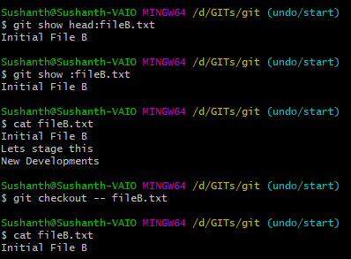
Undoing the changes
Lets overwrite content in Working directory with content from STAGING
git checkout -- fileB.txt
Checkout has multiple functions by putting two hypens -- you are saying you are dealing with a file
Copy fileB.txt from staging area to working directory
Repository
Staging area
Working directory
Overwriting content from staging
to working directory
Current Staging area

Slide 45
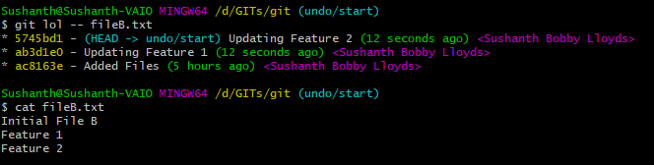
Undoing the changes
Retrieving file from earlier commit (C2)
SETUP :- Generating some random commits
echo "Feature 1" >> fileB.txt
git commit -am 'Updating Feature 1'
echo "Feature 2" >> fileB.txt
git commit -am 'Updating Feature 2'
git lol -- fileB.txt
Notes:
Head is a pointer which usually points to a branch by which git know where it is now. This head usually points to the tip of the branch and tip of the branch contains the latest commit.
If you have messed up file in working directory and staging area and want to startover use option(2)

Slide 46
Undoing the changes
Retrieving file from earlier commit, say (C1)
git checkout fb6b0ad -- fileB.txt
Copies fileB.txt from that commit point in repo to staging area
Copies fileB.txt from staging area to working directory
Working Directory
Staging Area
Local REPO
HEAD
MASTER
fileB.txt
Initial File B
Feature 1
Feature 2
fileB.txt
Initial File B
fileB.txt
Initial File B
C3
C2
C1
fileB.txt
Initial File B
git checkout fb6b0ad -- fileB.txt
Note : If you had something in WD file, above command will overwrite the changes.
Notes:
Head is a pointer which usually points to a branch by which git know where it is now. This head usually points to the tip of the branch and tip of the branch contains the latest commit.
If you have messed up file in working directory and staging area and want to startover use option(2)

Slide 47

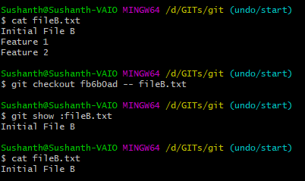
Undoing the changes
Retrieving file from earlier commit, say (C1)
git checkout fb6b0ad -- fileB.txt
Copies fileB.txt from that commit point in repo to staging area
Copies fileB.txt from staging area to working directory
Working directory
& Staging area
Checking out fileB.txt from specific
commit point
Current Staging area
Working directory

Slide 48
Undoing the changes
Other Undo options using git checkout
Git checkout -- .
dot stands for the current directory
Command means, Do a git checkout of the current directory (recursively)
Same as “git checkout .” . Unless you have named a branch “ . “.
Git checkout <branch> .
Command means, checkout current folder(recursively) from <branch>

Slide 49
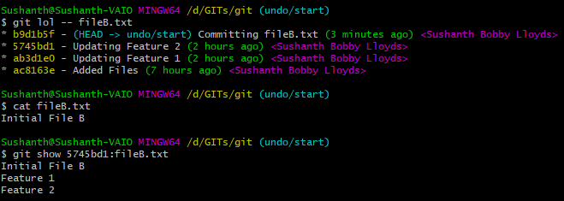
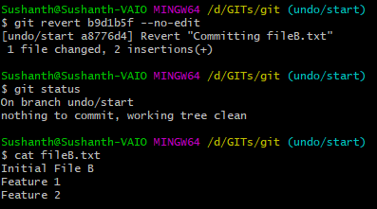
Undoing the changes – git revert
This reverts commit and then does a commit to record that event.
Does not alter history.
Present
We want to get
Back to
By reverting the current commit, we can get back previous data.
--no-edit mean we are accepting the default message for the revert, this message is used for the commit

Slide 50
Git revert – Second example
One
2
Three
4
git revert, reverts commit operation and appends a new commit and does not remove that commit from history
If we Revert commit B, it will undo only the line changed in that commit, and leave the changes introduced in commit #3, so the result will be :
MASTER
C
One
2
Three
Four
B
One
Two
Three
4
One
Two
Three
Four
A
Continued…

Slide 51
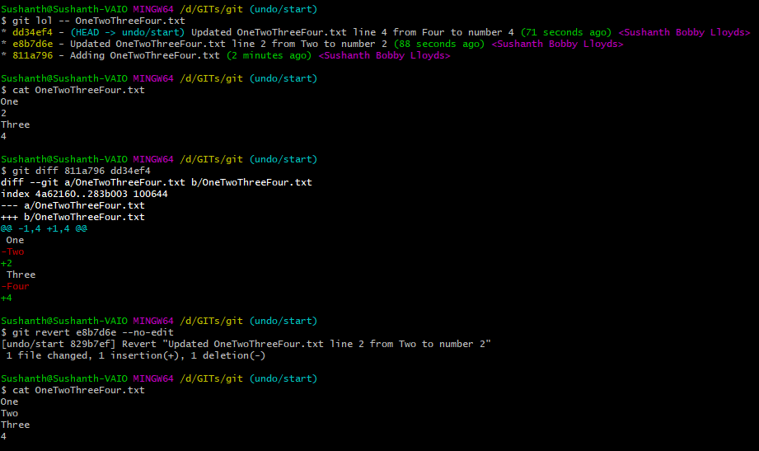
Git revert – Second example
Git undoes by reversing this operations
Note : If you have a new file that is being staged and committed, if you reverted that commit. File will be gone from the working directory.
Notes:
git revert HEAD~1 --no-edit

Slide 52
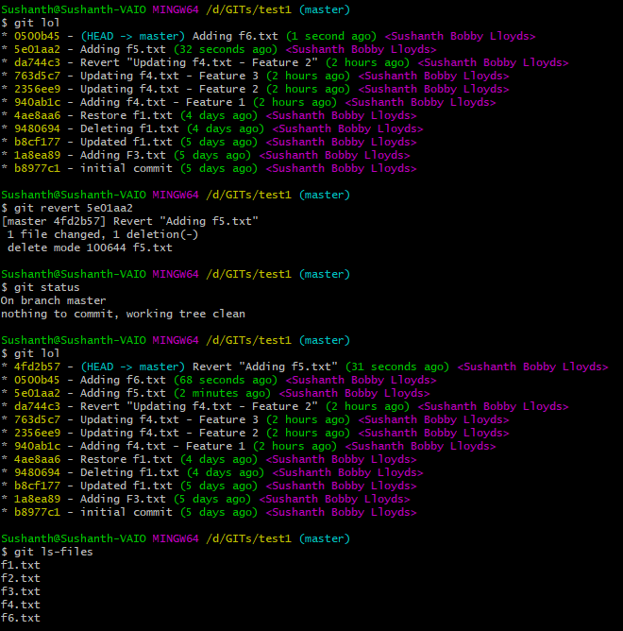
UNDO : reverting a commit which added new files
Adding new two new files in two new commit
echo "F5 INITIAL" > f5.txt
git add f5.txt
git commit -m 'Adding f5.txt'
echo "F6 INITIAL" > f6.txt
git add f6.txt
git commit -m 'Adding f6.txt‘
Reverting “Adding f5.txt”. This basically add a new revert commit.
vi editor will open save the default comment by closing :wq
Git lol
List files in the latest commit (see f5.txt is gone)

Slide 53
Git Resets

Slide 54
git reset
There are 3 types of reset
Soft
git reset –soft <commit>
Resets HEAD to <commit> doesn’t touch index/stage or working directory. Puts all the deltas between <commit> to HEAD in index/staging
Mixed
git reset –mixed <commit>
Default mode.
Copies files from <commit> to staging/index. Working directory untouched.
Hard
git reset –hard <commit>
Copies files from <commit> to staging/index
Copies files from staging/index to working directory

Slide 55
git reset --soft
E
MASTER
E
HEAD
Initially HEAD is pointing to “E”.
→
Once its soft reset to C. “D” and “E” which are in the staging area will show as “changes to be committed” as they are not yet committed
D
D
MASTER
C
C
HEAD
B
B
A
A
Continued…

Slide 56
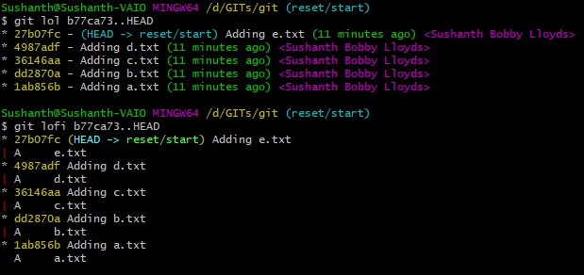
Git reset – Test preparation
echo 'initial a' > a.txt
git add a.txt
git commit -m 'Adding a.txt'
echo 'initial b' > b.txt
git add b.txt
git commit -m 'Adding b.txt'
echo 'initial c' > c.txt
git add c.txt
git commit -m 'Adding c.txt'
echo 'initial d' > d.txt
git add d.txt
git commit -m 'Adding d.txt'
echo 'initial e' > e.txt
git add e.txt
git commit -m 'Adding e.txt'
Continued…
Notes:
echo 'initial a' > a.txt
git add a.txt
git commit -m 'Adding a.txt'
echo 'initial b' > b.txt
git add b.txt
git commit -m 'Adding b.txt'
echo 'initial c' > c.txt
git add c.txt
git commit -m 'Adding c.txt'
echo 'initial d' > d.txt
git add d.txt
git commit -m 'Adding d.txt'
echo 'initial e' > e.txt
git add e.txt
git commit -m 'Adding e.txt'

Slide 57
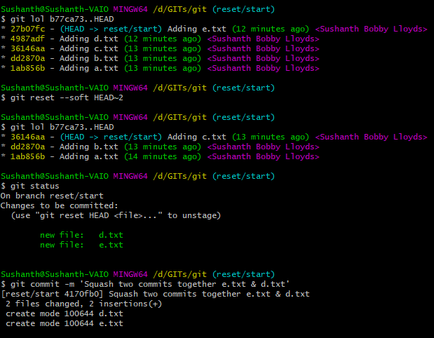
git reset --soft
Resets HEAD to <commit> doesn’t touch index/stage or working directory.
Plan is to soft reset and go two commits back.
After soft resetting two commits back, two files added in those commits are in staging.
HEAD is pointing to the new tip of the master branch
This commit will contain both the new files.
This technique can be used to squash many smaller commits

Slide 58
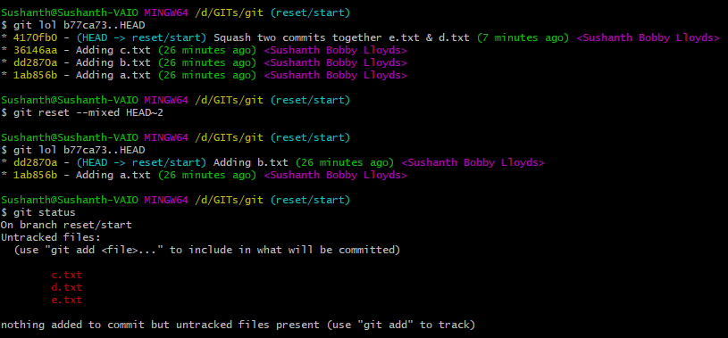
git reset --mixed
Copies files from <commit> to staging/index. Working directory untouched.
Plan is to mixed reset and go two commits back.
Since the commits involved in adding new files, mixed-reset removed files from repo and unstaged them

Slide 59
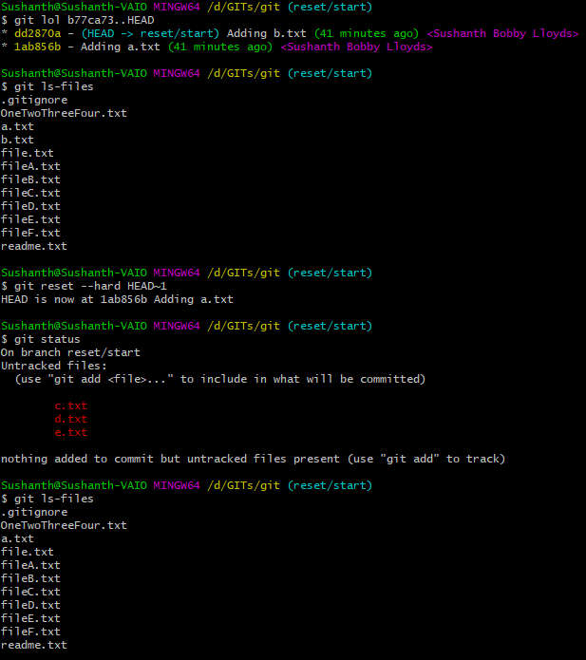
git reset --hard
Plan is to mixed reset and go two commits back.
This shows the current files in the repo
After git reset --hard , b.txt is missing.
Not in list of untracked files
Not in the repo as well
If you remember the commit hash in the above example dd2870a, you can again perform a git reset –hard dd2870a
Bring the file back

Slide 60
Git Undo's
git stash pop/apply : new files
git stash pop/apply
STASH
Working
Directory
Stage/Index
Local Repo
master
git stash list
git status
git log
git stash push
git show :fn
git show HEAD:fn
git rm --cached
git reset –soft
git checkout -- fn
git reset –mixed
git reset --hard /// git checkout HEAD

Slide 61
Git Stash

Slide 62
Git stash
Used to temporarily save half-done work.
It takes the changes of TRACKED modified files in your working directory and staging area and saves it in a stack and later when you require them you can reapply.
Following are the basic stash commands :
git stash - Add changed content to stash
git stash list - List items in stash
git stash show -p stash@{n} - View the content of stash with difference
git stash apply - Reapply the latest item in stash
git stash clear - Clears the stash

Slide 63
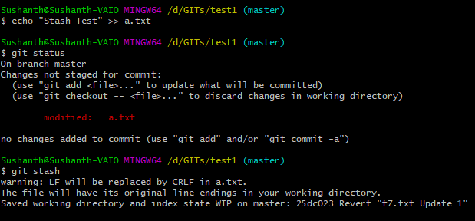

Stash : Adding changes to stash
Two ways to add changes to stash
Git stash
This is the default. Git adds default comment to the stash which will be latest commit comment.
Git stash push –m “Added on dd/mm/yyyy”

Slide 64

Stash : Listing items in stash
Git stash list
stash@{0}
Most recently created stash
Has the user given comment
stash@{1}
It’s the stash that was created before stash@{0}
Has the default comment
Always most recent is at 0

Slide 65
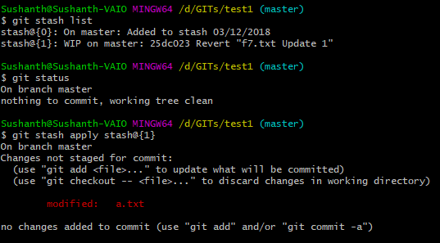
Stash : Applying the stashed item
git stash apply
Above command will apply the most recent stash. i.e., stash@{0}
git stash apply stash@{1}
To apply specific stash

Slide 66
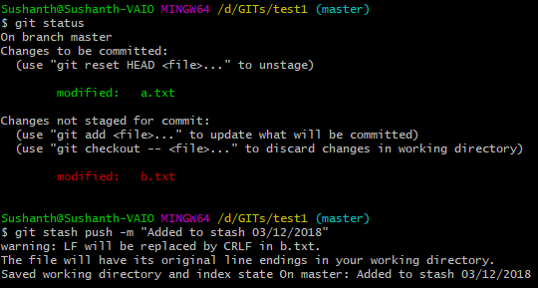
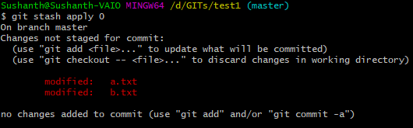
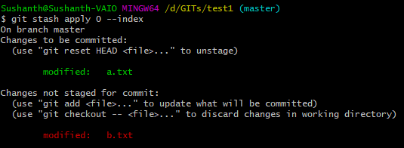
Stash : Applying the stashed item
git stash apply 0
Stack number can be also used directly.
In the recent stash, while stashing, a.txt was staged and b.txt wasn’t.
Above command while applying from stash, unstages by default.
To reapply the staged items, run with --index

Slide 67
Stash : Clearing items from stash
Three ways to remove items from stash
git stash pop 1
Applies the stash@{1} as specified
Drops item stash@{1} from stash stack
Git stash drop 0
Drops item stash@{0} from stash stack
Git stash clear
Empties the stash

Slide 68
Branching
Branches allow us to work on different versions of the same file in parallel. Edits on one branch is independent of other branch.
At Later point it can be decided whether to merge or not.
Default branch is MASTER

Slide 69
Branching
HEAD
Always do remember
Branch is a lightweight movable pointer which will always point to latest commit
Head will always point to the tip of the branch(i.e., latest commit)
If head points to a different commit point, then head is in a state referred to as ‘detached HEAD’
MASTER
A
Default branch
git init
git commit (a)

Slide 70
Branching
HEAD
Always do remember
Branch is a lightweight movable pointer which will always point to latest commit
Head will always point to the tip of the branch(i.e., latest commit)
If head points to a different commit point, then head is in a state referred to as ‘detached HEAD’
MASTER
A
B
git init
git commit (a)
git commit (b)

Slide 71
Branching
HEAD
Always do remember
Branch is a lightweight movable pointer which will always point to latest commit
Head will always point to the tip of the branch(i.e., latest commit)
If head points to a different commit point, then head is in a state referred to as ‘detached HEAD’
MASTER
A
B
C
git init
git commit (a)
git commit (b)
git commit (c)

Slide 72
Detached HEAD
HEAD
git checkout <hash4b>
When you do this git rolls back to that commit point.
To get back to master branch
git checkout master
MASTER
A
B
C
git commit (a)
git commit (b)
git commit (c)
git checkout <hash4b>
git checkout master
Continued…
Notes:
git checkout head^
git checkout master^

Slide 73
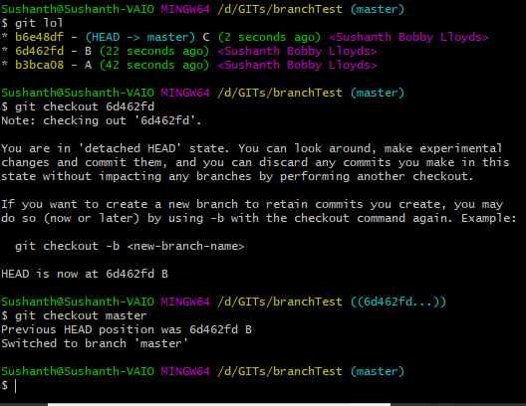
Detached HEAD

Slide 74
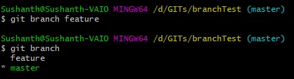
Branching
HEAD
MASTER
A
B
C
feature
Both of these can
Confirm that you are
In master branch
git commit (c)
git checkout <hash4b>
git checkout master
git branch feature
git branch
Continued…

Slide 75

Branching
MASTER
A
B
C
feature
If you give
git checkout –b feature
Creates a new branch
Checkout to new branch feature
git checkout <hash4b>
git checkout master
git branch feature
git branch
git checkout feature
HEAD
Continued…

Slide 76
Branching
MASTER
A
B
C
D
git checkout master
git branch feature
git branch
git checkout feature
git commit (D)
feature
HEAD
Continued…

Slide 77
Branching
MASTER
A
B
C
D
E
git branch feature
git branch
git checkout feature
git commit (D)
git commit (E)
feature
HEAD
Continued…

Slide 78
Branching
HEAD
MASTER
F
A
B
C
D
E
git checkout feature
git commit (D)
git commit (E)
git checkout master
git commit (f)
feature
Continued…

Slide 79
Branching
HEAD
MASTER
F
A
B
C
D
E
Once we are ready with the feature, we can merge
git checkout feature
git commit (D)
git commit (E)
git checkout master
git commit (f)
feature
Continued…

Slide 80
Branching
HEAD
Two steps of merging
Checkout into the branch you want merge INTO (ALREADY DONE)
Merge the branch you want to merge
MASTER
F
A
B
C
D
E
git checkout feature
git commit (D)
git commit (E)
git checkout master
git commit (f)
feature
Continued…

Slide 81
Branching
Two steps of merging
Checkout into the branch you want merge into
Merge the branch you want to merge
HEAD
F
MASTER
A
B
C
G
D
E
git commit (D)
git commit (E)
git checkout master
git commit (f)
git merge feature –m “G”
feature
Continued…

Slide 82
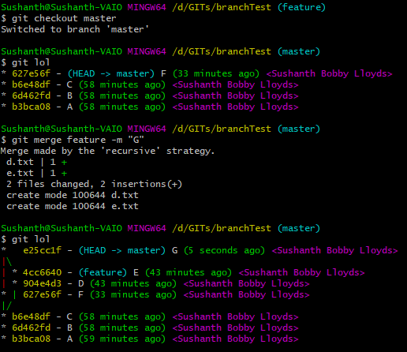
Understanding MERGE graph
HEAD
feature
MASTER
G
E
F
D
C
B
A

Slide 83
Understanding MERGE graph
HEAD
feature
MASTER
G
Make a note of this strategy
E
F
D
C
B
A

Slide 84
Branching – Lets rewind a bit
Remove commit (F), for that lets do a hard reset
git reset --hard (c)
HEAD
F
MASTER
A
B
C
G
D
E
git commit (D)
git commit (E)
git checkout master
git commit (f)
git merge feature –m “G”
feature
Continued…

Slide 85
Branching
Now we have commits only in the feature branch, now let proceed to merge feature branch into master
HEAD
MASTER
A
B
C
D
E
git commit (E)
git checkout master
git commit (f)
git merge feature –m “G”
git reset –hard (c)
feature
Continued…

Slide 86
Branching – Fast-forward merge
Since there is a linear path(C -> D -> E) because there is no commits in master
All git has to do is fast-forward the current branch tip from C to E
HEAD
MASTER
A
B
C
D
E
No new merge commits.
ONE CLEAN LINE
git checkout master
git commit (f)
git merge feature –m “G”
git reset –hard (c)
git merge feature –m “g”
feature
Continued…

Slide 87
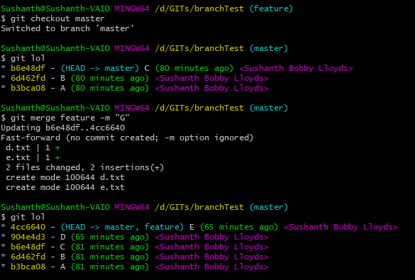
Understanding Merge Graph
E
feature
MASTER
HEAD
D
C
B
A

Slide 88
Going back to the recursive strategy
HEAD
feature
MASTER
G
E
Recursive Strategy (or) 3-way merge
“the commit on the branch you’re on isn’t a direct ancestor of the branch you’re merging in, Git has to do some work. In this case, Git does a simple three-way merge, using the two snapshots pointed to by the branch tips and the common ancestor of the two.”
Git uses 3 commits to generate a merge commit
Last commit of master
Last commit of feature
Common ancestor commit (base commit)
F
D
C
B
A
Notes:
https://git-scm.com/book/en/v2/Git-Branching-Basic-Branching-and-Merging
https://www.atlassian.com/git/tutorials/using-branches/git-merge
https://www.youtube.com/watch?v=AJqup7axNX8

Slide 89
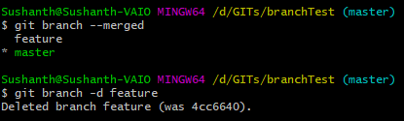
Delete branch
Once the branches are merged they can be deleted
Git branch --merged
Show all the merged branches
Git branch –d feature
Deletes the branch

Slide 90
Delete branch
NOTE:- Git will not allow a branch to be deleted if its not merged. Use the below command to forcibly delete the branch.
git branch –D feature

Slide 91
Use of stash during branch jumps
Note:- If you have made some unstaged changes in the working directory and try to checkout to new branch. You will not be able to do it. During then use,
git stash

Slide 92
git reflog
Git keeps track of updates to the tip of branches using a mechanism called reference logs, or "reflogs.“
Reflogs track when Git refs were updated in the local repository.
Git refs are updated when below commands are executed
Git checkout
Git reset
Git merge
Common reflog commands are
git reflog ←→ git reflog show HEAD
Git reflog show <<branch>>
Git reflog stash
Reflog keeps information only for 30/90 days as per global config settings.

Slide 93
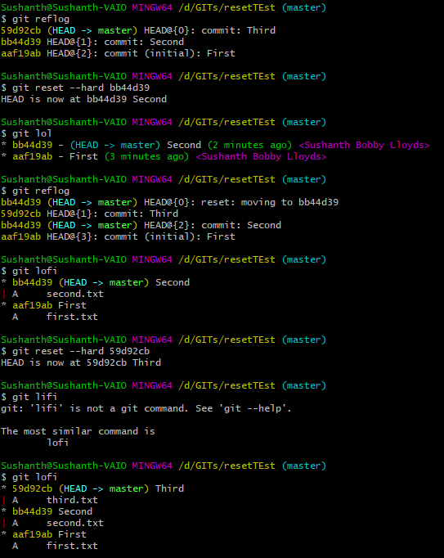
git reflog
Using hash from reflog even reset—hard can be backed out.
Scenario
We have added 3 files in 3 commits and did a reset—hard to second commit.
After looking at hash from reflog, we did again a reset—hard to third commit.

Slide 94
git rebase
Rebase means take series of commits and changes its base.
This command will merge another branch into the branch where you are currently working, and move all of the local commits that are ahead of the rebased branch to the top of the history on that branch
Man page: “git rebase: Forward-port local commits to the updated upstream head”.
Use rebase only locally on unpublished commits.
Notes:
https://nathanleclaire.com/blog/2014/09/14/dont-be-scared-of-git-rebase/

Slide 95
git rebase
Git checks which is the latest commit both branch have in common(ancestor)
Git looks at the current branch and see's what has changed and saves it internally and removes it.
Git gets the feature branch commits and applies on top of master(ie., on top of ancestor commits). Now both the branch will look the same.
Next git applies the master commits which it had saved internally on top of feature branch commits.
Have this in mind
A is B’s base
B is C’s base
C is F’s base
C is D’s base
D is E’s base
HEAD
MASTER
A
B
C
F
Below commands were executed
git checkout master
git rebase feature
D
E
Result of above commands would be :
Rebase current branch(master) on top of feature basically it will put commit F after E
feature

Slide 96
git rebase
Git checks which is the latest commit both branch have in common(ancestor)
Git looks at the current branch and see's what has changed and saves it internally and removes it.
Git gets the feature branch commits and applies on top of master(ie., on top of ancestor commits). Now both the branch will look the same.
Next git applies the master commits which it had saved internally on top of feature branch commits.
Have this in mind
A is B’s base
B is C’s base
C is F’s base
C is D’s base
D is E’s base
HEAD
MASTER
A
B
C
F
Below commands were executed
git checkout master
git rebase feature
D
E
Result of above commands would be :
Rebase current branch(master) on top of feature basically it will put commit F after E
feature

Slide 97
git rebase
Git checks which is the latest commit both branch have in common(ancestor)
Git looks at the current branch and see's what has changed and saves it internally and removes it.
Git gets the feature branch commits and applies on top of master(ie., on top of ancestor commits). Now both the branch will look the same.
Next git applies the master commits which it had saved internally on top of feature branch commits.
HEAD
MASTER
F
A
B
C
Below commands were executed
git checkout master
git rebase feature
D
E
Result of above commands would be :
Rebase current branch(master) on top of feature basically it will put commit F after E
feature

Slide 98
git rebase
Git checks which is the latest commit both branch have in common(ancestor)
Git looks at the current branch and see's what has changed and saves it internally and removes it.
Git gets the feature branch commits and applies on top of master(ie., on top of ancestor commits). Now both the branch will look the same.
Next git applies the master commits which it had saved internally on top of feature branch commits.
HEAD
MASTER
F
A
B
C
D
E
Below commands were executed
git checkout master
git rebase feature
D
E
Result of above commands would be :
Rebase current branch(master) on top of feature basically it will put commit F after E
feature

Slide 99
git rebase
Git checks which is the latest commit both branch have in common(ancestor)
Git looks at the current branch and see's what has changed and saves it internally and removes it.
Git gets the feature branch commits and applies on top of master(ie., on top of ancestor commits). Now both the branch will look the same.
Next git applies the master commits which it had saved internally on top of feature branch commits.
HEAD
MASTER
A
B
C
D
E
F`
Now you can delete feature branch as all the feature branch changes are available in the master.
D
E
Result of above commands would be :
Rebase current branch(master) on top of feature basically it will put commit F after E
feature

Slide 100
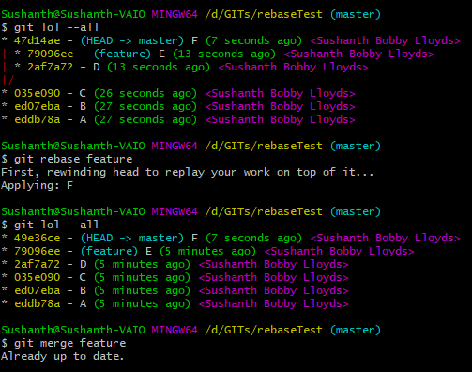
git rebase
(feature) branch has two additional commits D & E
(master) branch has one additional commit F
Git rebase replays master commit F on top of feature commits.
Now you can see commits D&E after commit C and F commit is the HEAD( latest) which it had applied last with new commit SHA1 value that’s rebasing.
Now you don’t need to merge feature branch to master its already up to date. So, feature branch can be deleted.
git branch –d feature

Slide 101
Rebasing
What we have seen is, rebasing master on top of feature.
Now lets see rebasing feature on top of master
HEAD
MASTER
A
B
C
D
E
F`
D
E
feature

Slide 102
git rebase
Git checks which is the latest commit both branch have in common(ancestor)
Git looks at the current branch and see's what has changed and saves it internally and removes it.
Git gets the master branch commits and applies on top of feature(ie., on top of ancestor commits). Now both the branch will look the same.
Next git applies the feature commits which it had saved internally on top of master branch commits.
Have this in mind
A is B’s base
B is C’s base
C is F’s base
C is D’s base
D is E’s base
MASTER
A
B
C
F
D
E
Below commands were executed
git checkout feature
git rebase master
feature
Result of above commands would be :
Rebase current branch(feature) on top of master basically it will put commit D&E after F
HEAD

Slide 103
git rebase
Git checks which is the latest commit both branch have in common(ancestor)
Git looks at the current branch and see's what has changed and saves it internally and removes it.
Git gets the master branch commits and applies on top of feature(ie., on top of ancestor commits). Now both the branch will look the same.
Next git applies the feature commits which it had saved internally on top of master branch commits.
Have this in mind
A is B’s base
B is C’s base
C is F’s base
C is D’s base
D is E’s base
MASTER
A
B
C
F
D
E
Below commands were executed
git checkout feature
git rebase master
feature
HEAD

Slide 104
git rebase
Git checks which is the latest commit both branch have in common(ancestor)
Git looks at the current branch and see's what has changed and saves it internally and removes it.
Git gets the master branch commits and applies on top of feature(all it has to do is move the pointer)
Next git applies the feature commits which it had saved internally on top of master branch commits.
D
E
feature
HEAD
MASTER
A
B
C
F
Below commands were executed
git checkout feature
git rebase master

Slide 105
git rebase
Git checks which is the latest commit both branch have in common(ancestor)
Git looks at the current branch and see's what has changed and saves it internally and removes it.
Git gets the master branch commits and applies on top of feature(all it has to do is move the pointer).
Next git applies the feature commits which it had saved internally on top of master branch commits.
D
E
feature
HEAD
MASTER
A
B
C
F
Below commands were executed
git checkout feature
git rebase master

Slide 106
git rebase
Git checks which is the latest commit both branch have in common(ancestor)
Git looks at the current branch and see's what has changed and saves it internally and removes it.
Git gets the master branch commits and applies on top of feature(all it has to do is move the pointer)
Next git applies the feature commits which it had saved internally on top of master branch commits.
MASTER
A
B
C
F
D`
E`
Below commands were executed
git checkout feature
git rebase master
feature
Result of above commands would be :
Rebase current branch(master) on top of feature basically it will put commit F after E
HEAD

Slide 107
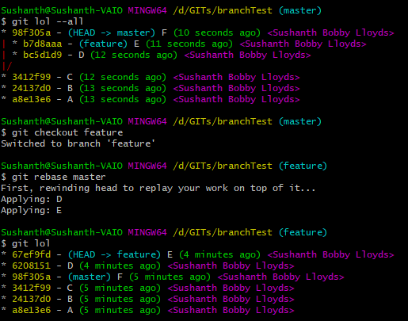
git rebase
(feature) branch has two additional commits D & E
(master) branch has one additional commit F
Checkout to feature
Git rebase replays feature commits D & E on top of master commits.
Now you can see commits D&E on top of master branch with new SHA1 commit values
Now you can merge feature branch into master. It will be a fast-forward merge.
git checkout master
git merge feature
This is the most commonly used method when rebasing

Slide 108
Handling Conflicts
Conflicts occur when there are changes to the same position/line of the file at different commits or branches
Usually conflicts occur during
Reverting changes ( part 1 )
Merging branches ( part 2 )

Slide 109
Handling Conflicts : git revert
F4 INITIAL
Feature 1
Feature 2
Feature 3
Here we are trying to revert (B) and there will be a conflict because to undo the change in (B), git it will see what it was in the previous commit (A) and update that value in all the subsequent commits. Since the line itself wasn’t there. We have a conflict. It has to be handled manually.
MASTER
C
B
F4 INITIAL
Feature 1
Feature 2
A
F4 INITIAL
Feature 1
Continued…

Slide 110
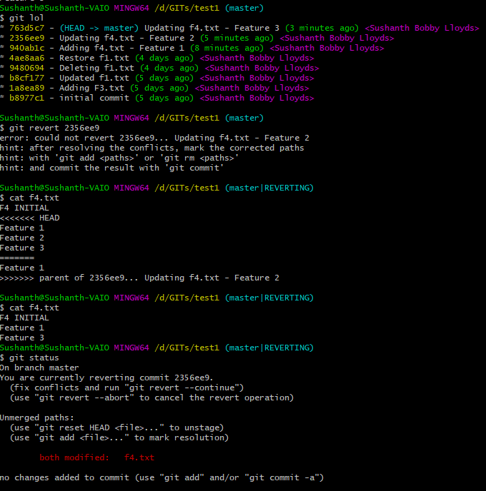
Handling Conflicts : git revert
Remove Feature 2
As multiple changes are in same file. Changes are conflicting
Manually remove the change that you don’t‘ require including conflict markers.
Latest commit contains this ( HEAD )
This is what parent of 2356ee9 contains(ie., 940ab1c)
F4.txt is manually updated
Since we have made changes to f4.txt, below are next set of actions
Git add f4.txt
Git revert --continue
Continued…

Slide 111
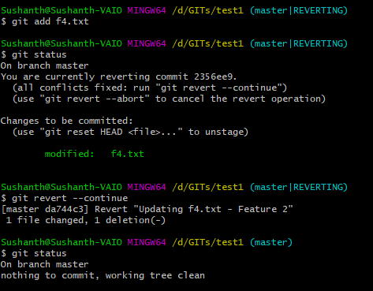
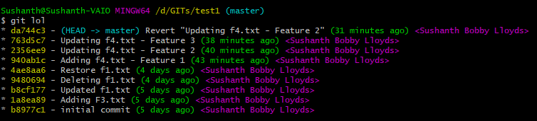
Handling Conflicts : git revert
As mentioned in previous slide
Git add f4.txt
Git revert –continue
Advantages history is maintained

Slide 112
Handling Conflicts : Merging branches
Scenario : Team Lead asks two developers to write two features in a rexx program.
Developer 1 will have to code ADD
Team Lead codes the below main logic
add:procedure
get argument a
get argument b
say 'Adding a + b'
return 0
/*** rexx ***/
a = 10
b = 5
c = add(a, b)
d = sub(a, b)
say 'Addition : 'c
say 'Subractiion : 'd
exit
Developer 2 will have to code SUB
sub:procedure
get argument a
get argument b
say ‘Subracting a - b'
return 0
Continued…

Slide 113
Handling Conflicts : Merging branches
/*** rexx ***/
a = 10
b = 5
c = add(a, b)
d = sub(a, b)
say 'Addition : 'c
say 'Subractiion : 'd
exit
A
ADD
Developer 1 creates ADD branch for
ADD()
DEV 1 : git branch ADD
DEV 2 : git branch SUB
SUB
Developer 2 creates SUB branch for
SUB()
Continued…

Slide 114
Handling Conflicts : Merging branches
/*** rexx ***/
a = 10
b = 5
c = add(a, b)
d = sub(a, b)
say 'Addition : 'c
say 'Subractiion : 'd
exit
A
ADD
SUB
/*** rexx ***/
a = 10
b = 5
c = add(a, b)
d = sub(a, b)
say 'Addition : 'c
say 'Subractiion : 'd
exit
/*** rexx ***/
a = 10
b = 5
c = add(a, b)
d = sub(a, b)
say 'Addition : 'c
say 'Subractiion : 'd
exit
Git add prg.rexx
Git commit
Git add prg.rexx
Git commit
add:procedure
get argument a
get argument b
say 'Adding a + b'
return 0
sub:procedure
get argument a
get argument b
say ‘Subracting a - b'
return 0
Continued…

Slide 115
Handling Conflicts : Merging branches
/*** rexx ***/
a = 10
b = 5
c = add(a, b)
d = sub(a, b)
say 'Addition : 'c
say 'Subractiion : 'd
exit
Team Lead executes
git merge ADD SUB
A
B
Conflict occurs
ADD
If you want to abort merge
Git merge --abort
SUB
/*** rexx ***/
a = 10
b = 5
c = add(a, b)
d = sub(a, b)
say 'Addition : 'c
say 'Subractiion : 'd
exit
/*** rexx ***/
a = 10
b = 5
c = add(a, b)
d = sub(a, b)
say 'Addition : 'c
say 'Subractiion : 'd
exit
add:procedure
get argument a
get argument b
say 'Adding a + b'
return 0
sub:procedure
get argument a
get argument b
say ‘Subracting a - b'
return 0
Continued…

Slide 116
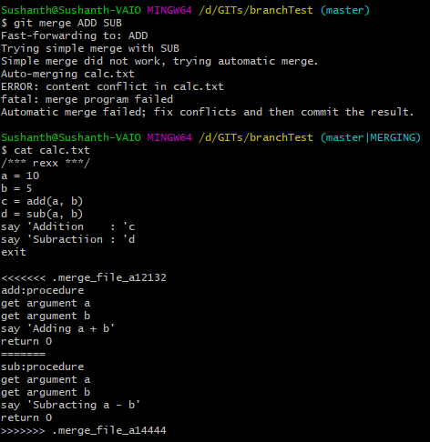
Handling Conflicts : Merging branches
Steps for resolve the conflicts
git checkout master
git merge add sub
git status
<<edit the file & remove all the conflict markers >>
git add calc.txt
git commit –m “merged add sub”
This part is ignored as all files have this content
ADD feature
SUB feature
Conflict occurred because in each branch both the features are in the same lines. So, while merging git doesn’t know whether to keep both the features or one of them.
HUMAN REQUIRED
Continued…

Slide 117
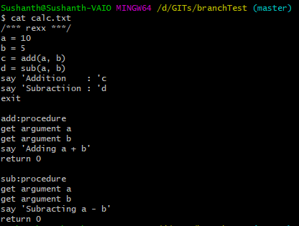
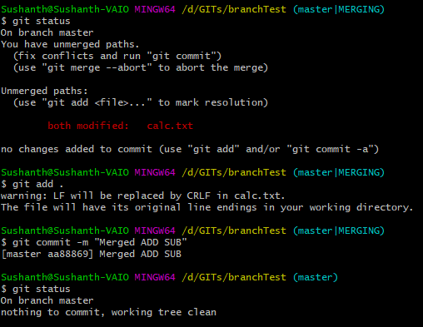
Handling Conflicts : Merging branches
Manually update the file calc.txt
“git status” will tell you how to proceed
Stage the modified file Git add .
Commit the staged file
Delete the branches ( ADD & SUB )
Continued…

Slide 118
Handling Conflicts : Merging branches
A
B
/*** rexx ***/
a = 10
b = 5
c = add(a, b)
d = sub(a, b)
say 'Addition : 'c
say 'Subractiion : 'd
exit
add:procedure
get argument a
get argument b
say 'Adding a + b'
return 0
sub:procedure
get argument a
get argument b
say 'Subracting a - b'
return 0
F1
F2
Now the psuedo-code is ready lets proceed to write the actual function.
We will be performing exactly the same sequence as before
Create two new branches ( ADD & SUB )
In ADD(), Developer 1 will work on ADD()
In SUB(), Developer 2 will work on SUB()
Continued…

Slide 119
Handling Conflicts : Merging branches
/*** rexx ***/
a = 10
b = 5
c = add(a, b)
d = sub(a, b)
say 'Addition : 'c
say 'Subractiion : 'd
exit
add:procedure
a = arg(1)
b = arg(2)
say 'Adding a + b'
return a + b
sub:procedure
get argument a
get argument b
say 'Subracting a - b'
return 0
/*** rexx ***/
a = 10
b = 5
c = add(a, b)
d = sub(a, b)
say 'Addition : 'c
say 'Subractiion : 'd
exit
add:procedure
get argument a
get argument b
say 'Adding a + b'
return 0
sub:procedure
a = arg(1)
b = arg(2)
say 'Subracting a - b'
return a - b
B
ADD
SUB
Continued…

Slide 120
Handling Conflicts : Merging branches
Team Lead executes
git merge ADD SUB
/*** rexx ***/
a = 10
b = 5
c = add(a, b)
d = sub(a, b)
say 'Addition : 'c
say 'Subractiion : 'd
exit
add:procedure
a = arg(1)
b = arg(2)
say 'Adding a + b'
return a + b
sub:procedure
a = arg(1)
b = arg(2)
say 'Subracting a - b'
return a - b
B
C
ADD
SUB
No conflicts this time as each of the
Developers updated different part of the code
different lines
Continued…

Slide 121

Handling Conflicts : Merging branches
Merge completed successfully without a conflict.
Additionally if you notice here we have been merging two branches to master in a single command and strategy we are using in ‘octopus’
“This resolves cases with more than two heads, but refuses to do a complex merge that needs manual resolution. It is primarily meant to be used for bundling topic branch heads together. This is the default merge strategy when pulling or merging more than one branch. “

Slide 122
Git Internals

Slide 123
Git Architecture
Git maintains two primary data structures
Index
Stores information about current working directory and changes made to it
Object Database
Blobs (files)
Stored in .git/objects
All files are stored as blobs
It has only file’s data does not contain any meta data information or even file name.
Blob name is just hash of data it contains
Trees
Represents one-level directory information
Records blob identifier, pathnames and meta data
It can also refer other trees(sub-folders)
Commits
One object for every commit
Contains hash of parent, name of author, time of commit, and hash of the current tree
Tags
Human readable name to a commit
To efficiently use disk space and network bandwidth, git compresses the objects and stores in pack-files which are also placed in .git/objects directory

Slide 124
Git Architecture
If earlier slide looks complicated, just remember this
Git stores content of your files in blob objects
You folders become tree object which contains blob objects(files) and other tree objects(sub folders)
Commit is a type of object that always point to a tree. Once they are set they cannot be updated.

Slide 125
SHA1 hash
Git uses SHA1 hash of the content as file name, partially(i.e., first 2 characters as folder name and remaining 38 characters as filename in .git/object/ directory.
Suppose 8ab686eafeb1f44702738c8b0f24f2567c36da6d is the hash of the content it is stored as
.git/objects/8a/b686eafeb1f44702738c8b0f24f2567c36da6d
SHA1 values are 160-bits, 20-bytes. Represented in 40 Hex Characters.
It is considered as globally unique because you can have 2¹⁶⁰ or 1⁴⁸ possible SH1 hashes (i.e., 1 with 48 zeros after it )
Important characteristic of SHA1 hash computation is it always computes the same hash for identical content, regardless of where the content is. In other words, the same file content in different directories and even on different machines yields the exact same SHA1 hash ID. Thus, the SHA1 hash ID of a file is a globally unique identifier.
Any change to the file makes SHA1 hash change and thus creating new version of the file.
A collision is very rare but possible( if one hashed 2⁸⁰ random blobs )
Notes:
FAT32 - Maximum number of files per directory: 216 - 1 (65,535)
NTFS - Maximum number of files: 232 - 1 (4,294,967,295)
ext2, ext3 - Maximum number of files per directory: ~1.3 × 1020 (performance issues past 10,000)
ext4 - Maximum number of files per directory: unlimited

Slide 126

How git hashes content
Git hash-object
This command computes hash of the content and optionally can write it to the object database
It is one of plumbing commands
Git has two types of commands
Porcelain – User facing commands/functions
Plumbing – Low level commands /functions

Slide 127

Contents of .git directory
Repository private config
Repository Description
Current checkout reference
Hooking Scripts
Git Objects Commits, Trees and Blobs
Information about Packs & Indexes
Information about heads
& tags

Slide 128
Git Objects – Initial Commit
7891011 | BLOB | Size(n)
11 22 33 44 55 66 77 88 99 A1 B1 C1 D1 E1 F1 11 22 33 44 55 66 77 88 99 A1 B1 C1 D1 E1 F1 11 22 33 44 55 66 77 88 99 A1 B1 C1 D1 E1
A
000001 | COMMIT
TREE | 123456
PARENT | NIL
AUTHOR | sushanth
COMMITTER | bobby
Size | n
INITIAL COMMIT
123456 |  | TREE |  | Size(n)
100644 | BLOB | 7891011 | Untitled.txt
040000 | TREE | 1213141 | ./pictures
1213141 |  | TREE |  | Size(n)
100644 | BLOB | 987456 | Untitled.jpg
MASTER
987456 | BLOB | Size(n)
11 22 33 44 55 66 77 88 99 A1 B1

Slide 129
Git Objects – Second Commit
B
654789 | BLOB | Size(n)
MASTER
000011 | COMMIT
TREE | 654321
PARENT | 000001
AUTHOR | sushanth
COMMITTER | bobby
Size | n
Second COMMIT
654321 |  | TREE |  | Size(n)
100644 | BLOB | 7891011 | Untitled.txt
040000 | TREE | 1213141 | ./pictures
100644 | BLOB | 654789 | a.png
789101 | BLOB | Size(n)
987456 | BLOB | Size(n)
123456 |  | TREE |  | Size(n)
100644 | BLOB | 7891011 | Untitled.txt
040000 | TREE | 1213141 | ./pictures
A
1213141 |  | TREE |  | Size(n)
100644 | BLOB | 987456 | Untitled.jpg

Slide 130

Git Objects
Overall this will be the structure of git internal objects

Slide 131


Objects, Hashes & Blobs
All the git objects can be found in .git/objects folder. Since we are in a new repo, its empty.
Create a new file with content & commit
Now objects directory has 3 files – 3 Objects. They are Commit, Tree & Blob
echo "Hello, World!" > HW.txt
git add .
git commit -m "Initial Commit"
Packs & Indexes

Slide 132

Commit, Tree & Blob
To know which is a commit, use
git lol
To know which is a file, use
git ls-files -s
Now we can easily guess that “ee” is a tree
Notes:
You can use below command to see files in the staging area. git ls-files –s
100644 : File attributes of the object. Regular non-executable file
100755 : Executable file

Slide 133
git cat-file
git cat-file –t <hash>
To know type of the object
git cat-file –p <hash>
Pretty-print the content of the file
git cat-file –s <hash>
To know the size of the file

Slide 134

Knowing object type
git cat-file –t <hash>

Slide 135


Knowing content in the object
git cat-file –p <hash>
NOTE : Cannot use CAT command to print the contents as they are compressed

Slide 136


Knowing about tag details
Here you can see the difference between a normal tag and a annotated tag
Annotated tag is a object with its own SHA1 hash

Slide 137

Content in object – merged commit
C
ADD
SUB
Using “git cat-file” we are printing the content of the HEAD which will be pointing to the tip of the branch. Currently HEAD is pointing to commit created by a merge, so it has two parents.

Slide 138

git merge-base
How git is good at merging ?
git merge-base add sub
Notes:
It race backwards from these two points until these branches have same commit point

Slide 139

git rev-parse
Most of the git commands internally executes “git rev-parse” to get the full SHA1-hash
It basically converts short-hash into long-hash
Below you can see rev-parse used 4letter hash to get the actual hash
This is what we used earlier to get the tag hash

Slide 140

git rev-parse
Knowing rev-parse we can get the hash of commit or tree easily
git rev-parse commit-ish^{type}
git rev-parse head^{tree}
Shows current HEAD’s tree hash
git rev-parse head^{commit}
Shows current HEAD’s commit hash

Slide 141

Tip of branch always points to latest commit
-v means verbose

Slide 142

Everything is not lost till you run git gc
Git Garbage Collection
Executes a lots of housekeeping activities
Compresses all the objects and stores in pack file
Removes unreachable objects ( dangling commits )
Prerequisites
Need a dangling object

Slide 143

Git fsck
Git FileSystemChecK

Slide 144
git clean
One command to remove all the untracked, ignored files & folder from your working directory.
Once deleted cannot be retrieved as they are untracked
To see what file would be removed(dry run), use
git clean –n
Use below command to clean
git clean -dfx
d – remove any untracked folders
f – Force
x – remove ignored files as well

Slide 145
Git Flowchart
git diff HEAD
git diff
git diff –staged
git stash pop/apply : new files
git commit -a
Git pull request
git stash pop/apply
tag
git add/rm/mv
git commit
git push
STASH
Working
Directory
Stage/Index
Local Repo
master
Remote tracking ref
origin/master
Origin
/ Remote Repo
Upstream
/ Remote Repo
git stash list
git status
git show :fn
git log
git fetch
git stash push
git show HEAD:fn
git fork
git pull / clone
git rm --cached
git reset –soft
git checkout -- fn
git reset –mixed
branch --track
git reset --hard /// git checkout HEAD
git switch / cherry-pick / revert

Slide 146
Un git
rm –rf .git .gitignore
Notes:
Topics not included
Cherry-Pick

